Slide 1
IOT BASED GARBAGE MONITORING AND DISPOSAL SYSTEM
PRESENTED BY
P.NANDHINI (912620104008)
C.SUBASHINI (912620104018)
GUIDED BY
JAYAPRATHA.S
AP-CSE

Slide 2
DOMAIN - IOT
The Internet of Things, is a revolutionary concept that refers to the interconnection of everyday objects or "things" embedded with sensors, software, and other technologies, enabling them to collect and exchange data over the internet.
The core idea behind IOT is connectivity. It allows objects to communicate and interact with each other through the internet or other communication networks without requiring human intervention.

Slide 3
ABSTRACT
The Smart Garbage Monitoring and Disposal Support System (SGMDSS) is an innovative IOT-based solution designed to enhance garbage management. It automates waste monitoring and disposal by employing sensors in garbage bins. The system notifies cleaning personnel via an android mobile app about the garbage level. Additionally, real-time data is stored in the cloud and accessible through a webpage, ensuring efficient and timely waste disposal. This technology aims to improve cleanliness in metros, cities, and villages while minimizing manual intervention in the traditional garbage collection process.

Slide 4
OBJECTIVES
Data-Driven Decision Making
Enhanced Public Services
Integration with Smart City Initiatives
Efficient Resource Allocation

Slide 5
problem statement
How might we innovate solutions for the proper disposal of garbage waste, ensuring environmental safety, cost-effectiveness, and scalability across diverse settings such as public side and educational institutions?

Slide 6
EXISTING SYSTEM
MANUAL CLEANING
The existing system of waste management typically involves manual processes where cleaning workers physically visit each garbage bin to assess whether it needs emptying. This traditional approach often relies on scheduled collections rather than real-time monitoring of fill levels, leading to inefficiencies and potential issues such as overflow and littering.

Slide 7
DISADVANTAGES
Public Health Risks
Unnecessary man-power wastage
Garbage bins are overfilled and not cleared by the workers

Slide 8
PROPOSED SYSTEM
In this proposed system, IOT edge nodes are installed in the garbage bins or garbage collectors
IOT cloud platform is used to store and visualize the data that is captured by the nodes
All the cleaning workers will be equipped with the android application which retrieves all the data from the cloud. Whenever the garbage level visible in applicatin filled or not. if filled workers immediately dispose the garbage.

Slide 9
ADVANTAGES
Time cosumptions
Accurate data
Data-driven Decision Making
Enhanced Public Health and Environment
Cloud Connectivity

Slide 10
ALGORITHM
Algorithm used in our project is K-means algorithm.
K-means algorithm is an clustering which is a one type of unsupervised learning.

Slide 11
SYSTEM REQUIREMENTS
HARDWARE REQUIREMENTS
System : IOT kit
Main Components : Ardiuno,Ultrasonic sensor
Power Supply : 12 Volt
SOFTWARE REQUIREMENTS
Languages : Programming in C
Front End : Blynk app
Backend : Blynk Cloud

Slide 12
Literature survey
S.NO | TITLE | DESCRIPTION | DRAWBACKS
1. | Smart Waste Management Using IoT: A Review | This paper provides a IOT-based technologies and systems for waste management monitoring garbage levels. | May lack in-depth analysis. Limited focus on the environmental and socioeconomic impacts
2. | Implementation of an IoT-Based Garbage Monitoring System for Urban Areas. | This paper presents the design and implementation of an IoT-based garbage monitoring system tailored for urban environments. | Limited scalability and generalizability of the system. Lack of discussion on the long-term maintenance and operational costs

Slide 13
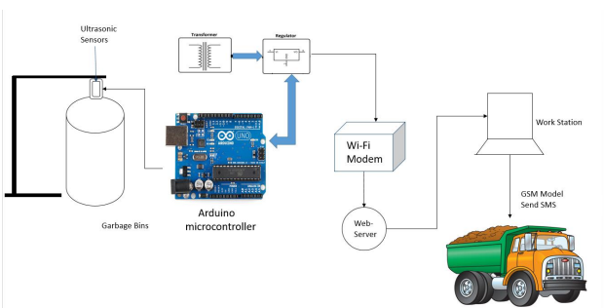
SYSTEM ARCHITECTURE

Slide 14
List of modules
COMMUNICATION ESTABLISHMENT
DATA EXTRACTING
FRONTEND AND BACKEND CONNECTIVITY

Slide 15
COMMUNICATION ESTABLISHMENT
A microcontroller is a compact integrated circuit designed to perform specific tasks within embedded systems. It consists of various functional blocks that work together to execute instructions and interact with external components.
The ESP8266 is not just a microcontroller; it's a versatile and widely used Wi-Fi module that integrates a powerful microcontroller with built-in Wi-Fi capability.

Slide 16
DATA EXTRACTING
The system utilizes sensors like ultrasonic sensors to gauge the level of garbage in the bins. Data is extracted from these sensors to ascertain the current fill level of each garbage bin.
The microcontroller gathers data from different sensors and modules connected to it, such as the ultrasonic sensor and GSM module. This data includes garbage level measurements, communication status, and system health information.

Slide 17
FRONTEND AND BACKEND CONNECTIVITY
The Blynk software platform is utilized for front end development, providing a user-friendly interface for monitoring and controlling the GMDSS from mobile devices. Blynk allows users to visualize data, receive notifications, and interact with the system through a customizable mobile application.
Blynk cloud is utilized as the cloud platform for storing and visualizing the data collected by the GMDSS. It enables real-time monitoring of garbage levels, historical data analysis, and remote access to system information.

Slide 18
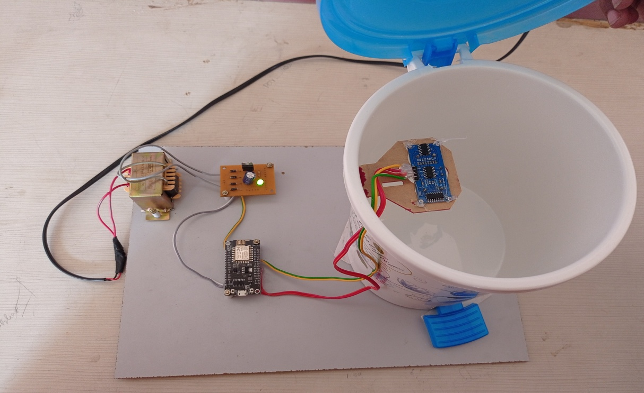
SCREENSHoTS
HARDWARE SETUP WITH BIN

Slide 19
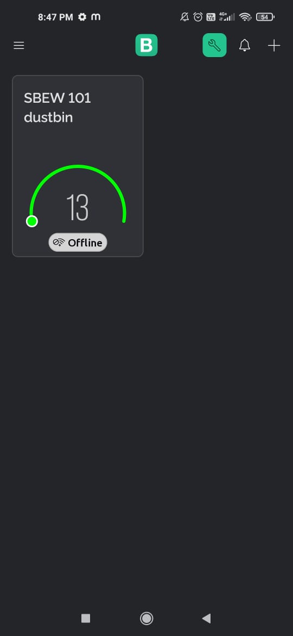
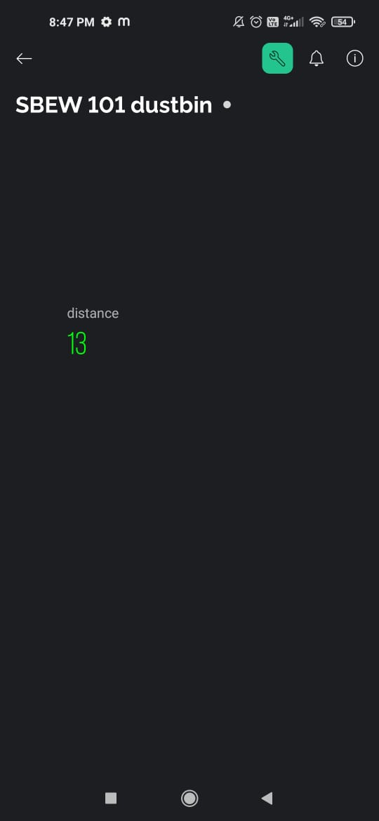
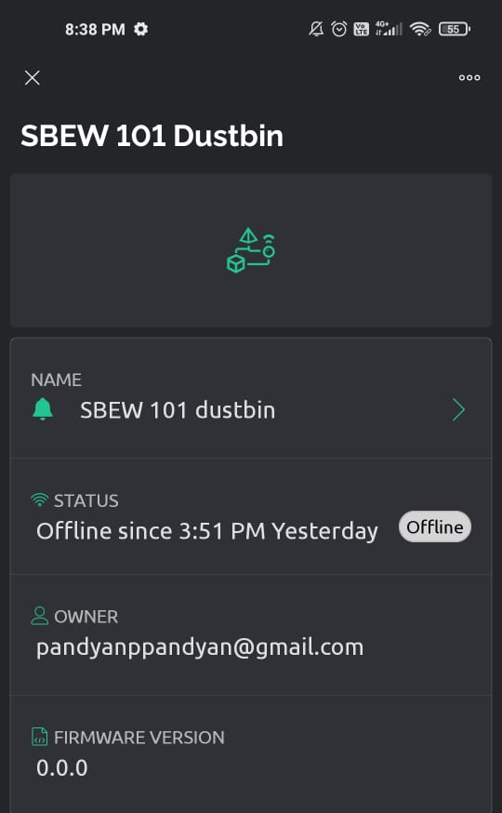
SCREENSHoTS
BLYNK APP

Slide 20
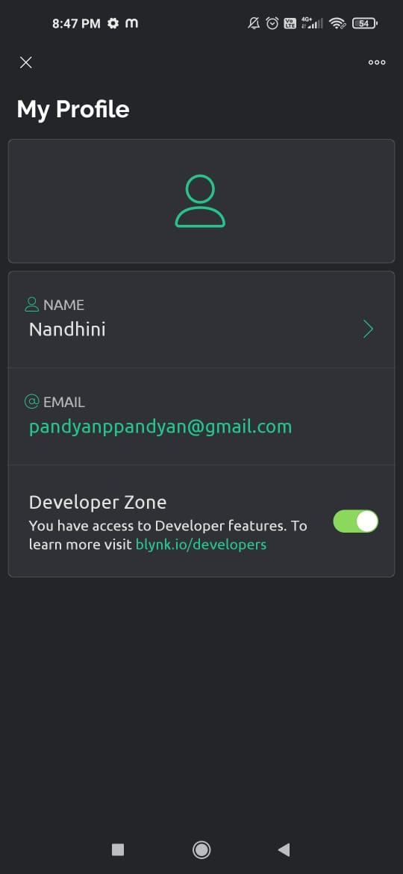
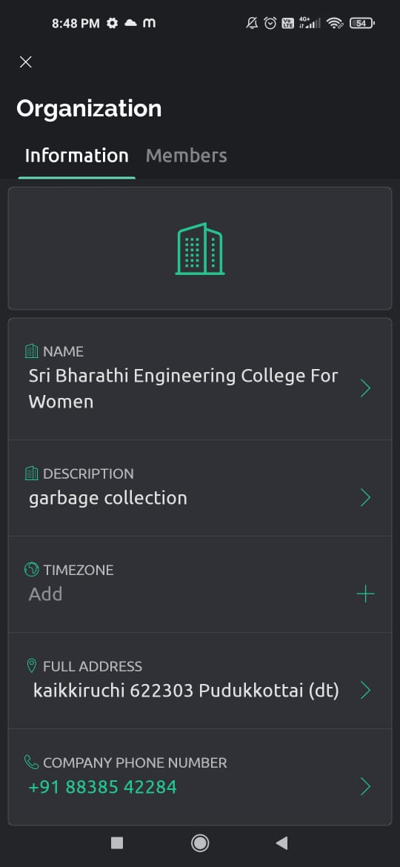
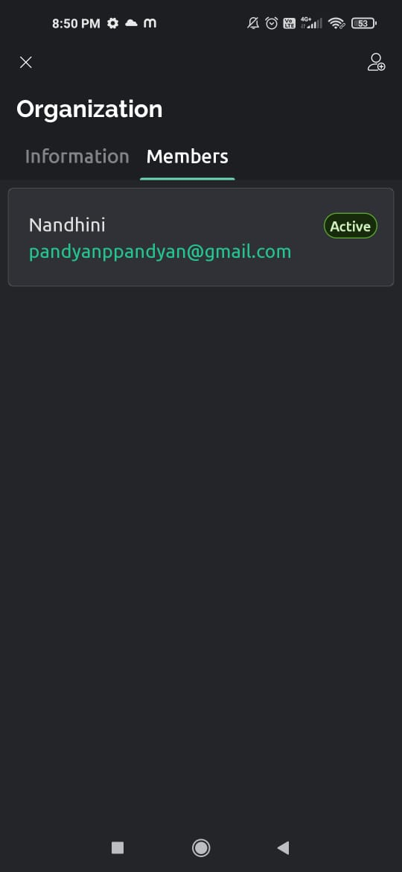

Slide 21
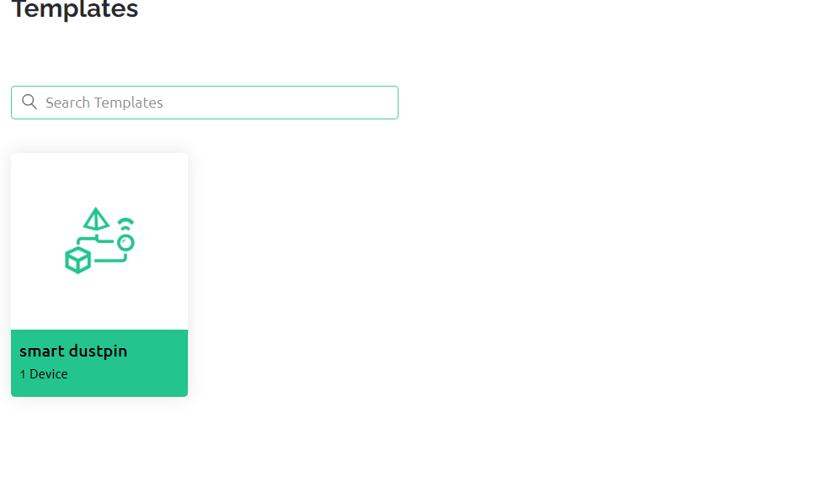
SCREENSHoTS
BLYNK CLoUD

Slide 22
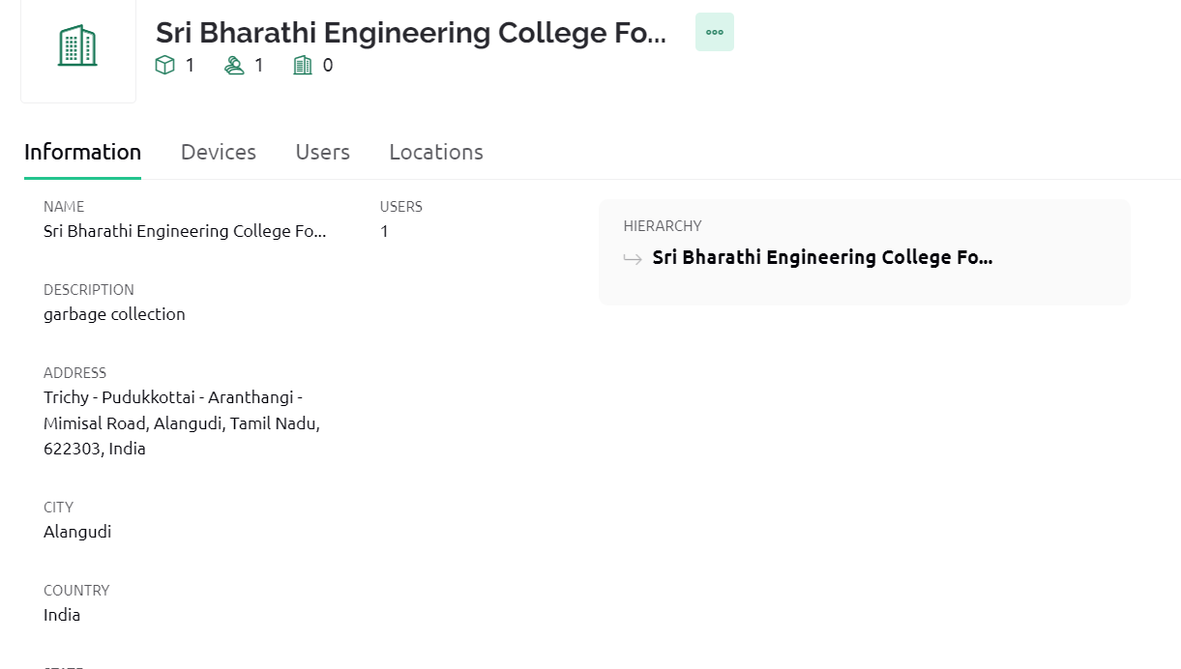

Slide 23
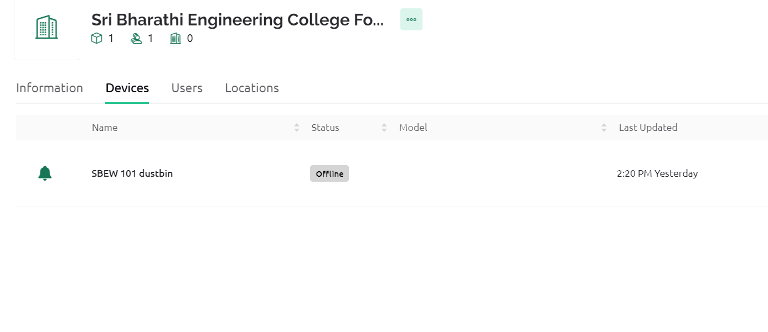

Slide 24
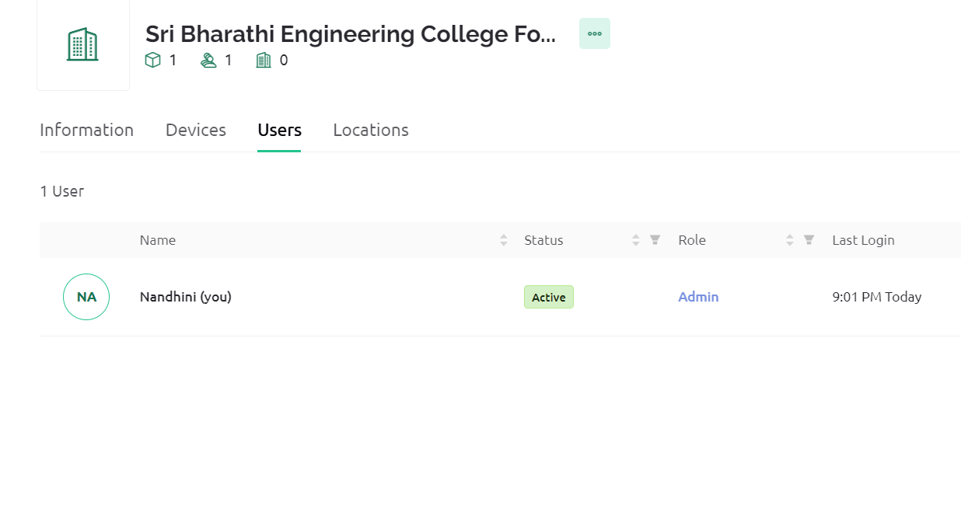

Slide 25
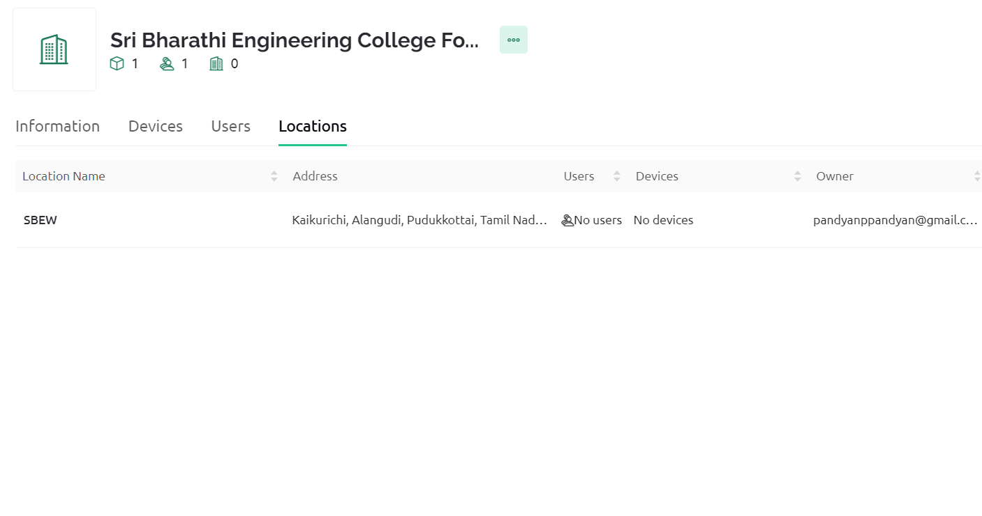

Slide 26
CONCLUSION
The proposed system is designed with integrating different modules like ESP8266 Wi-Fi modem, Ultrasonic Sensor, Arduino board, and a GSM module, which is a cost-efficient and economic smart garbage collection system By implementing this system, the problem can be minimized for excess accumulation of garbage from the dustbins in streets, residential houses, organizations, etc. The improved feature of any other similar systems already existing is, this proposed system can monitor the garbage level automatically with the help of sensors and transfer that information to the cleaning workers through an android application .

Slide 27
FUTURE ENHANCEMENT
Adding more garbage bins
Interconnect wide areas
Shortest path

Slide 28
REFERENCES
[1] Thangavel Bhuvaneswari et.al, (2020), Internet of things (IoT) based Smart Garbage monitoring system, Indonesian Journal of Electrical Engineering and Computer Science Vol. 20, No.2, November2020.
[2] Prof. Dr. Sandeep M et.al, (2017), Smart Garbage Monitoring System using Internet of Things (IOT), IJIREEICE, ISSN (Online) 2321 – 2004, Vol. 5, Issue 1
[3] S. S. Navghane, M. S. Killedar, and V. M. Rohokale, “ IoT Based Smart Garbage and Waste Collection Bin,” International Journal of Advanced Research in Electronics and Communication Engineering (IJARECE).

Slide 29
[4] Sharmad Pasha “ Thingspeak Based Sensing and Monitoring System for IoT with Matlab Analysis”, International Journal of New Technology and Research (IJNTR).
[5] S. R. Mugunthan, “Decision Tree Based Interference Recognition for Fog Enabled IOT Architecture”, Journal of trends in Computer Science and Smart technology (TCSST) (2020), Vol.02.
[6] David Nettikadan and Subodh Raj M.S. “ Smart Community Monitoring System using Thingspeak IoT Platform”, International Journal of Applied Engineering Research ISSN 0973-4562 Volume 13, Number 17 (2018) pp. 13402-13408.
[7] R. Dhaya, R. Kanthavel “ “A Wireless Collision Detection on Transmission Poles through IoT Technology”, Journal of trends in Computer Science and Smart technology (TCSST) (2020)

Slide 30
THANK YOU

